Slide 1
Rock vs Mine Prediction
Project Guide
D. Vamsi
Team members
G.Hemanth 19BQ1A0553
E.Jahnavi 19BQ1A0547
A.Vasundhara 19BQ1A0505
B.Raj Kumar 20BQ5A0505

Slide 2
Contents
Abstract
Problem Statement
Existing System
Proposed Solution
System Requirements
Algorithms Used
Screenshots
Conclusion

Slide 3
Abstract
Underwater Mine usage by the naval defense system provides great security but also possesses a threat to the marine life and submarine vessels as the mines can be easily mistaken for rocks.
We need a much more accurate system to predict the object as it is very dangerous if a mistake is made. To have a great accuracy we need accurate data to generate accurate results.
We worked on the data set which is provided by Gorman, R. P., and Sejnowski, T. J. (1988). The data is used to train the machine. This project presents a method for the prediction of underwater mines and rocks using Sonar signals.

Slide 4
Problem Statement
The problem statement is to predict metal or rock objects from sonar return data.
Each pattern is a set of 60 numbers in the range of 0.0 to 1.0. Each number represents the energy within a particular frequency band, integrated over a certain period.
The label associated with each record contains the letter R if the object is a rock and M if it is a mine (metal cylinder).

Slide 5
Existing System
In the existing system, the detection of mines is done by explosive ordnance disposal divers, marine mammals, video cameras on mine neutralization vehicles, laser systems, etc
It is not done by using a definite data set or equipment . This process can cause risk and loss to the marine life if it goes wrong.
As technology improved SONAR is being used as a primary tool to detect the mines.

Slide 6
Proposed Solution
We have proposed a predictive system to give accurate results and outcomes.
We utilized the dataset from "Analysis of Hidden Units in a Layered Network Trained to Classify Sonar Targets" by R. Paul Gorman and Terrence J.Sejnowski.
They employed SONAR to perform trials in a simulated region with metal cylinders in place of mines.
Sound Navigation and Ranging system works on sound waves to steer and detect objects. The object was struck with sonar signals from 60 various angles, and the results were recorded.

Slide 7
Proposed Solution (cont’d)
The dataset is then trained to the evaluated models. The Sonar output frequencies are sent into the predictive system as input. We use classification machine learning techniques to predict if the object is a Rock or a Mine.
Python and Supervised Machine Learning Classification algorithms are used to construct these prediction models

Slide 8
System Requirements
Software requirements
S.No | Software | Requirement
1 | Operating system | Windows/Mac/Linux/ Chrome Os
2 | Anaconda | Latest version
3 | Python | Latest Version

Slide 9
System Requirements (cont’d)
Hardware requirements
S.No | Hardware | Requirement
1 | Processor | 2.4 GHz Processor speed
2 | RAM | minimum 4GB
3 | disk space | 8 GB of available disk space minimum

Slide 10
Algorithms Used
Logistic Regression:- Logistic regression is a supervised learning classification algorithm used to predict the probability of a target variable occurring, based on a given dataset of independent variables.
Decision Tree:- Decision Tree algorithm belongs to the family of supervised learning algorithms which is used to create a training model that can use to predict the class or value of the target variable by learning simple decision rules inferred from prior data(training data).

Slide 11
K-Nearest Neighbor :- A k-nearest-neighbor algorithm, often abbreviated k-nn, is an approach to data classification that estimates how likely a data point is to be a member of one group or the other depending on what group the data points nearest to it are in.
4. Linear Discriminant Analysis:- Linear discriminant analysis (LDA) is a type of linear combination, a mathematical process using various data items and applying functions to that set to separately analyze multiple classes of objects or items.

Slide 12
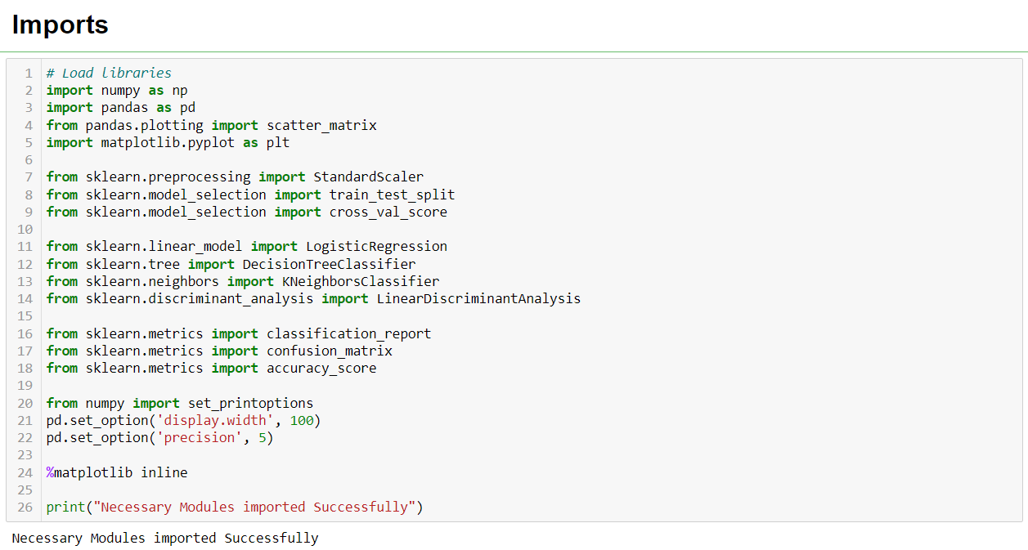
Screenshots

Slide 13
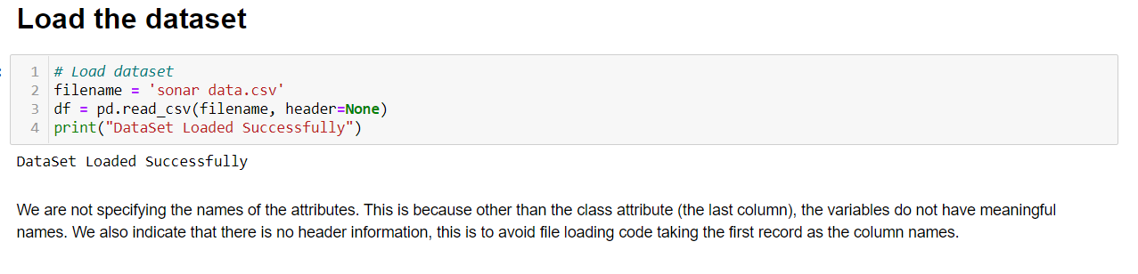

Slide 14
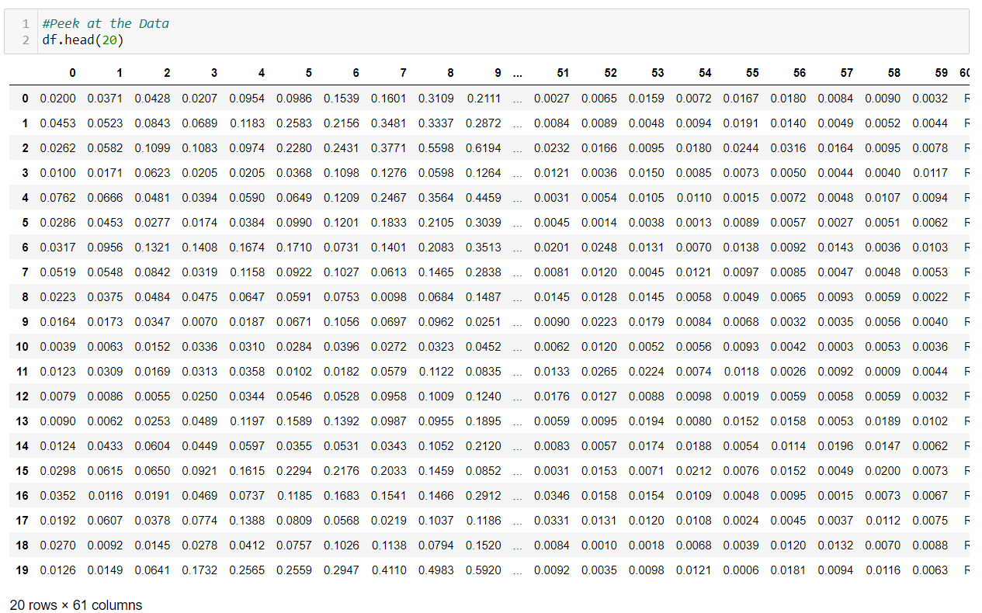
Summarize dataset

Slide 15
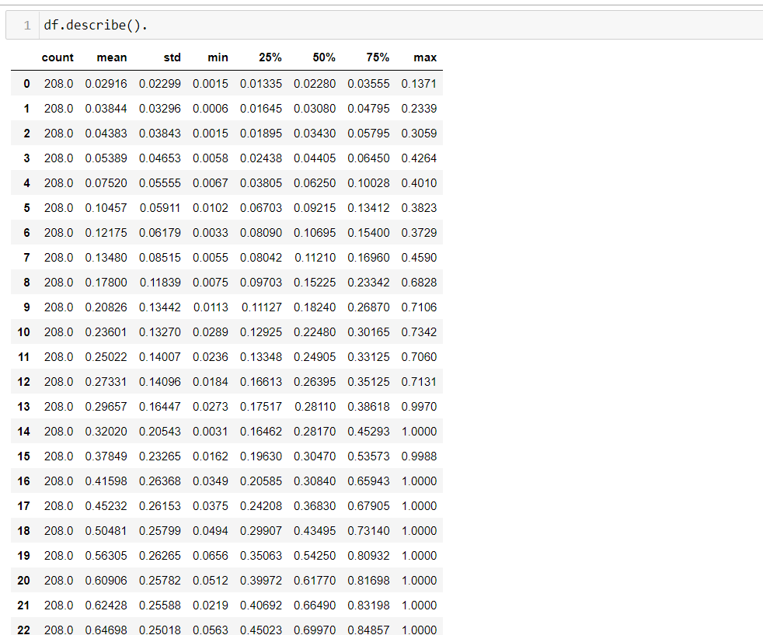
Describing Data Statistically

Slide 16
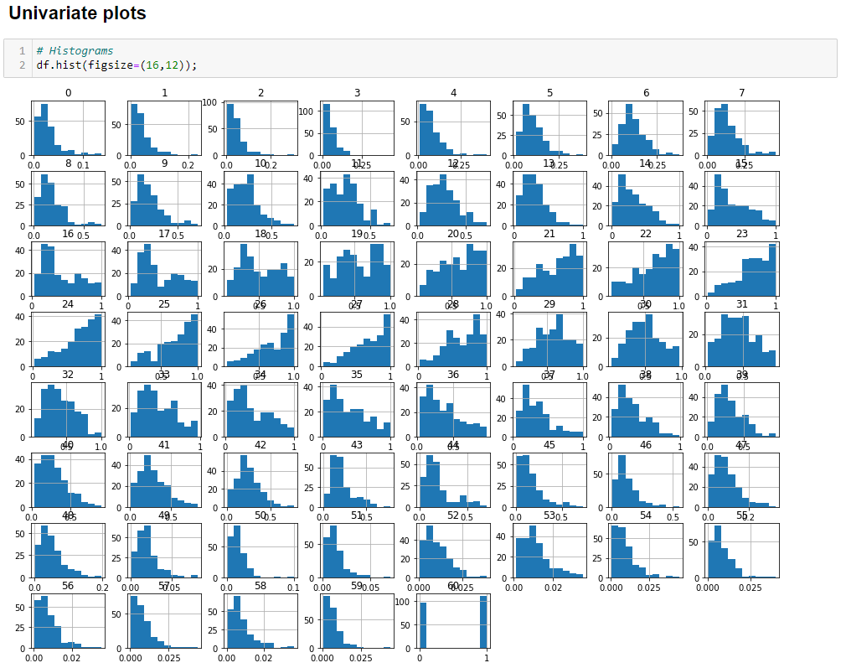

Slide 17
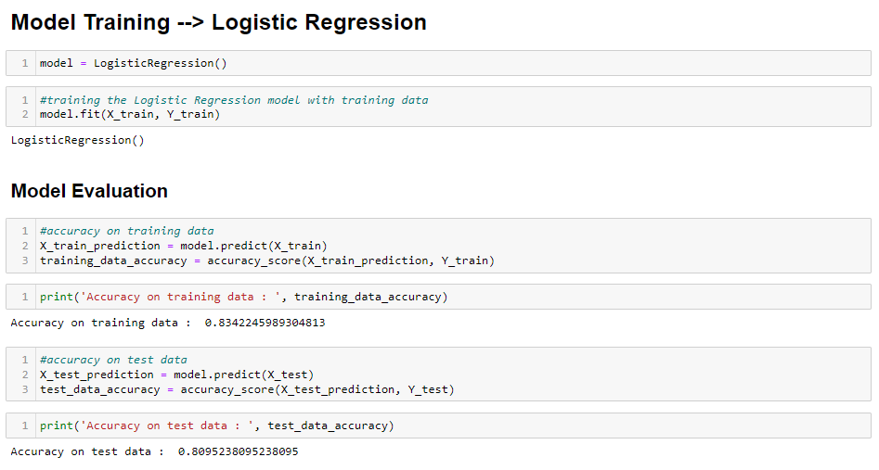

Slide 18
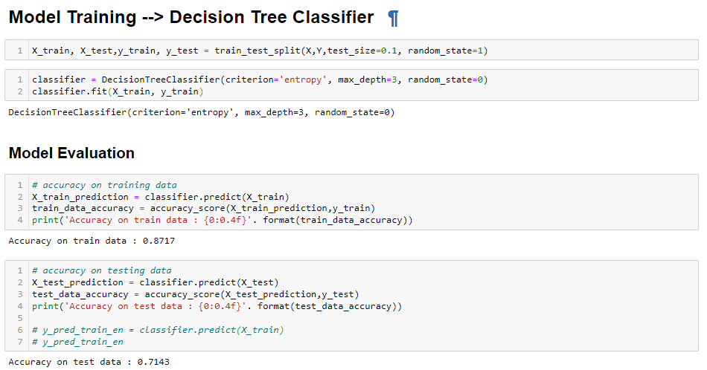

Slide 19
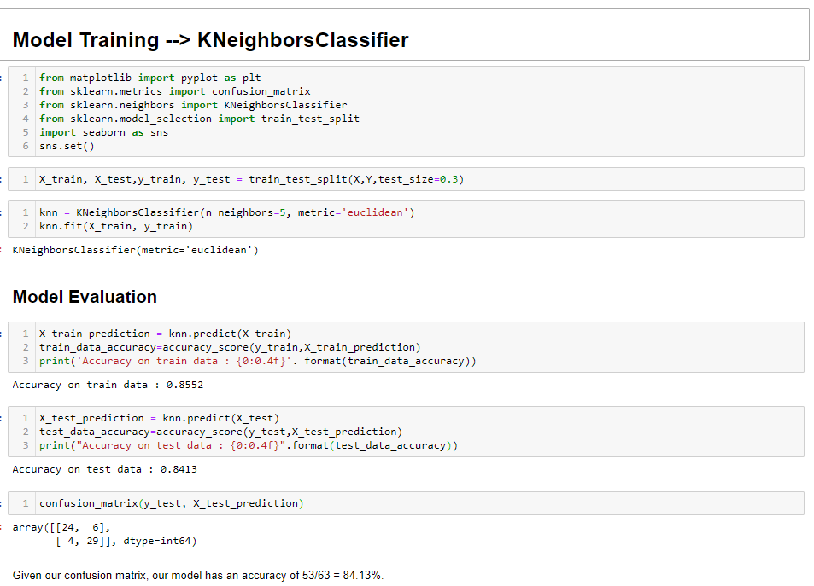

Slide 20
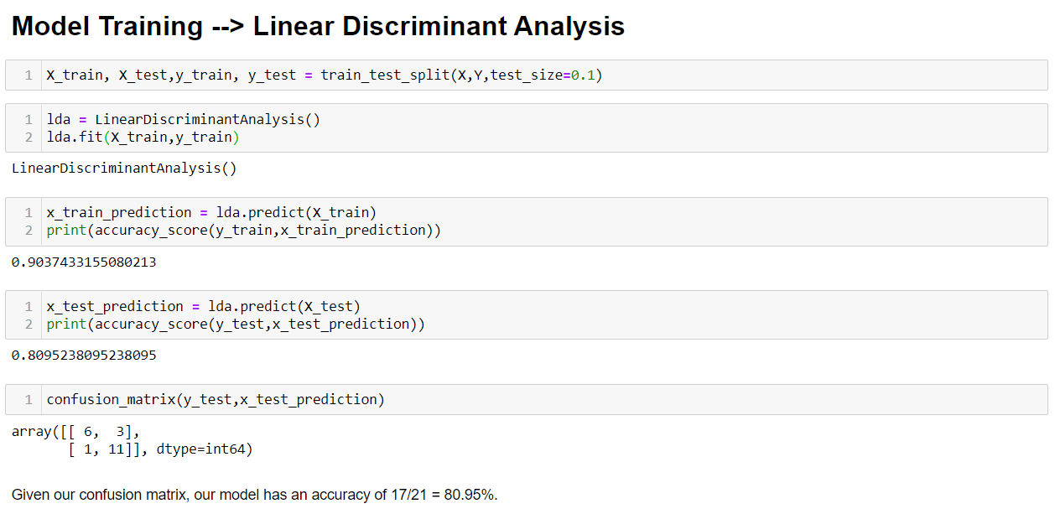

Slide 21
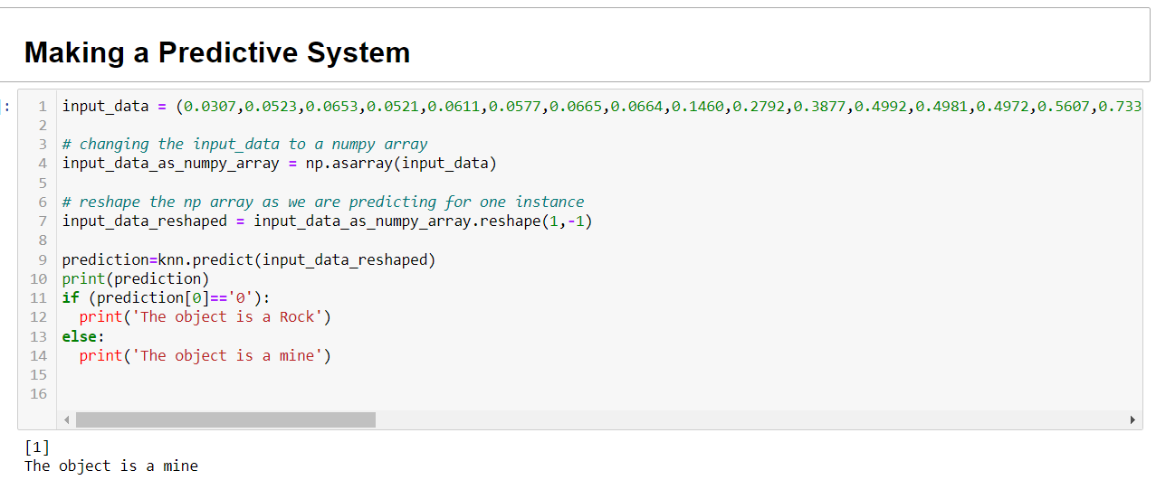

Slide 22
Conclusion
Our project “Rock vs Mine prediction” by the evaluation of machine learning algorithms is used to detect rocks and mines in the ocean bed.
There are two existing ways to detect a mine, one by using sonar signals and the other by using manpower. Using Sonar signals has been a better option as the risk for the latter is more.
The data is collected and stored in a CSV file. By using different machine learning techniques we can observe and understand the nature of the predictive system. By the evaluation of algorithms, we get to check and compare the accuracies to build a better performing prediction model.

